Slide 1


PORTFOLIO MANAGEMENT SERVICES
Private & Confidential, Not For Circulation

Slide 2
Who are we? – We live, eat and breathe Equities
“The stock market is a device for transferring money from the impatient to the patient.” – Warren Buffett
We are a team of highly experienced investment professionals with passion for investing. Green Lantern Capital is our endeavour to create long term value for all stakeholders by practicing disciplined approach to investment.

Slide 3
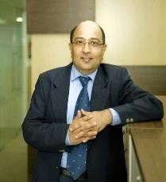
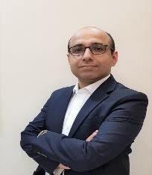
Team: 80+ Years of Cumulative Experience
Head or Tails. It’s the right team that makes the win.
Nilesh Doshi: | CEO & Managing Partner B.Tech. Chemical Engineering, IIT Bombay 30+ years of industry and equity market experience Worked with prestigious institutions like Pidilite, Praxair, Floatglass (I) and Edelweiss Financial Services. Distinguished track record of stock picking, with his investment ideas generating 5 – 10x returns.
Abhishek Bhardwaj: | Managing Partner & Principal Officer Chartered Accountant 20+ years of equity market experience Worked with institutions like Care Ratings, Reliance MF, Monsoon Capital, Heritage Capital. Last assignment as Head Equity at Star Union Daiichi Life Insurance, managing US$ 300 mn AUM. Abhishek has exposure to International best practices in Fund Management. The Heritage Fund was nominated among the top 5 Hedge funds in India in 2010 by Eureka Hedge.

Slide 4
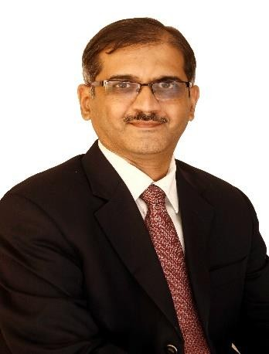
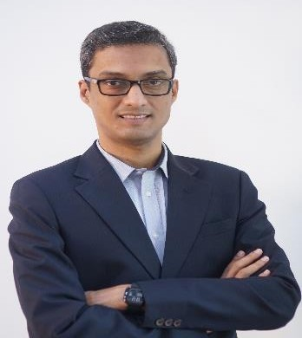
Team: 80+ Years of Cumulative Experience
Head or Tails. It’s the right team that makes the win.
Pradeep Gokhale: | Partner Investments Chartered Accountant, CFA – USA 25+ years of equity market experience Worked with institutions like TATA MF, ITI MF, CARE Ratings. Last assignment as Head Equity Head of Equity at ITI AMC for 4 years. Prior to ITI, he was at Tata MF for 15 years, Pradeep managed a broad spectrum of schemes across large-cap (Tata Large Cap Fund), multi- cap (Tata Large and Midcap Fund, Tata India Tax Savings Fund, and the equity portion of Tata Hybrid Equity Fund), offshore fund (Tata India Offshore Opportunities Fund), and thematic funds (Tata Ethical Fund) with assets under management exceeding Rs. 5,000 crores.
Nitin Pandey: | Partner Investments PGDBA 20+ years of equity market experience Worked with institutions like Reliance Capital AMC and Edelweiss Financial. Last assignment as Investment Manager at Miras Investments (USD 2 Bn. Investment firm, based out of Oman)

Slide 5


What to expect from us?
Do’s | Don’ts
Margin of Safety and capital preservation Disciplined approach Rigorous research and due diligence Long term focus Skin in the game Transparency & regular communication | Chasing expensive valuations Speculation Compromise with quality Investing for the sake of investing Benchmark hugging

Slide 6
Investment Approach: Rigor of Buying a Business
Business Selection:
Our starting point of any investment is to study and understand the business threadbare as we are business investors, which means investment to us is like buying a business. We invest in quality businesses that we understand well and which are likely to generate improvement in earnings and cash flows in the foreseeable future and avoid ones facing headwinds.
Judgement of Business cycles:
Our understanding of global macroeconomics along with the judgement of economic and business cycles helps us to endeavour to remain ahead of the curve in our investments. We may be a bit early in our investment and may have to wait for the businesses to bear fruit but have generally found them to be very rewarding with higher IRRs.
Margin of Safety:
Being early in identifying themes/stocks allows us the ‘Margin of Safety’ that we require before we invest. This entails that we will not shy away from being contrarian provided we are able to identify triggers for improvement in earnings and/or rerating of sector/stocks.
Thus, Investing in quality, growing businesses with desired margin of safety ensures capital protection, lower volatility and generates superior returns over a period of time.

Slide 7
Investment Approach
Quality companies in growth markets:
Strong franchises + good/ethical managements
Risk conscious approach:
Valuation Risk
Large market opportunities, strong competitive characteristics and high ROE
Earnings Risk
Balance Sheet Risk
Industry leaders
Over-ownership risk
Hunger for growth
Deep Research & Flexibility
Our investment principles:
Absolute return mindset
Flexible Approach:
Combine top down and bottom up approach
Asymmetric risk return approach
Capitalising on occasional tactical
opportunities
Undiscovered/underperformed
Ability to use cash as a hedge
Disciplined approach to selling

Slide 8
Our Investment Approach helps us focus on…
Asymmetric risk : reward
Earning inflection points High margin of safety
Growth and earning tailwinds
Disciplined selling: the most crucial and difficult part of investing
Run up in stocks & valuations getting rich
Significant change in investment rationale

Slide 9
Our Products
Small & Mid Cap Fund
Green Lantern Capital Growth Fund
The fund strategy endeavors to generate superior risk adjusted returns, in varying market conditions, by investing in Mid & Small Cap companies .
Ideal long-term investment (4-6 year Horizon) option for investors where we build a portfolio of companies that are Industry leaders, have potential to generate healthy ROE, and are trading at high margin of safety.
Portfolio Structure
Large Cap – 0 - 30%
Mid & small Cap - 70 -100%
Number of stocks: 20 - 25
Cash: Default Position
Benchmark: S&P BSE 500 TRI
Large & Mid Cap Fund
Green Lantern Capital Alpha Fund
The fund strategy endeavors to generate superior risk adjusted returns, in varying market conditions, by investing in large & Mid Caps within a broad Multi Cap allocation strategy.
Ideal long-term investment (4-6 years) option for investors to build a portfolio of market leaders with strong balance sheets, superior earnings growth and steady free cash flow generation.
Portfolio Structure
Large Cap – 0 - 40%
Mid Cap - 20 - 60%
Small Cap - 0 – 40%
Number of stocks: 20 - 25
Cash: Default Position
Benchmark: S&P BSE 500 TRI
Market Cap / Sector
Market Cap / Sector

Slide 10
Performance
Small & Mid Cap Fund |  |  |  | Large & Mid Cap Fund
Green Lantern Capital Growth Fund |  |  |  | Green Lantern Capital Alpha Fund
31-08-2025 | Portfolio | BSE 500 TRI | O/P | 31-08-2025 | Portfolio | BSE 500 TRI | O/P
1 Month | -2.17% | -1.75% | -0.4% | 1 Month | -2.4% | -1.75% | -0.6%
3 Months | -3.05% | -0.89% | -2.2% | 3 Months | -2.8% | -0.89% | -1.9%
6 Months | 8.2% | 13.6% | -5.4% | 6 Months | 11.4% | 13.6% | -2.2%
1 year | -5.3% | -4.7% | -0.6% | 1 year | -6.6% | -4.7% | -1.9%
2 years | 36.9% | 16.0% | 21.0% | 2 years | 27.5% | 16.0% | 11.5%
3 years | 40.2% | 14.4% | 25.8% | 3 years | 29.4% | 14.4% | 15.0%
4 years | 34.7% | 12.5% | 22.2% | 4 years | 25.3% | 12.5% | 12.8%
5 years | 48.8% | 20.3% | 28.4% | 5 years | 31.6% | 20.3% | 11.3%
Since Inception (Dec 2017) | 24.0% | 13.7% | 10.3% | Since Inception (Feb 2020) | 32.3% | 16.9% | 15.4%
Returns over 1 year period are annualized and adjusted for inflows/outflows.
Report Options : After Expenses , TWRR - Daily Valuation
31/08/2025 | Portfolio | BSE 500 TRI | 31/08/2025 | Portfolio | BSE 500 TRI
Sharpe Ratio 5 Yr. | 2.1 | 1.4 | Sharpe Ratio 5 Yr. | 1.6 | 1.4
Beta - 5 Yr. | 0.5 | 1 | Beta - 5 Yr. | 1 | 1

Slide 11


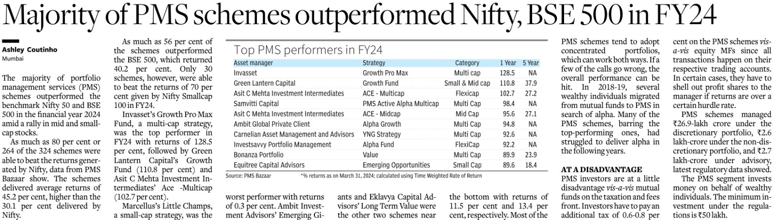




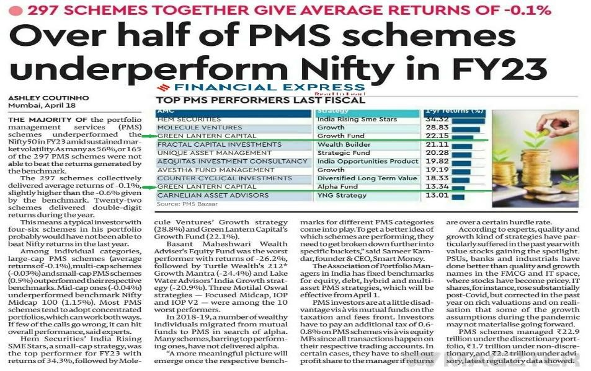
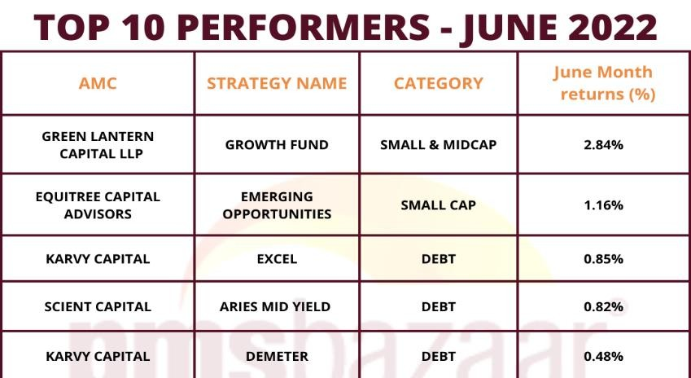
Media coverage

Slide 12
Way Forward :
Next 12 Months

Slide 13

USA
Trump: 2nd inning
New Economic doctrine: Complete reversal of earlier policies
Bring back manufacturing & jobs
Fight to protect Dollar hegemony, so Trade war !!!
Still Empire of the world: though rising debt (high Fiscal deficit:1.5 Trn $ p.a.) & slowing economy
Europe
A sinking ship
Migrant crisis
Political crisis
Economic crisis: Germany, France, Italy in near recession trajectory
Demographic headwinds
Japan
Another sinking ship
Govt. debt: GDP > 230%
Aging population
Behind China & USA in technological advancement

Slide 14
General questions
Is Trade war for bringing manufacturing & jobs to America or something beyond
Will America succeed to curtail China’s vertical growth (misusing/abusing all ethical & WTO guidelines)
ex: kept cost of capital very low
: export incentives
: not fulfilling environment norms
: copying/theft of technologies
If yes, at what cost?
Private & Confidential, Not For Circulation
14

Slide 15
India
GDP : 4.3 Trillion US$ apx.
Politically Stable
Fiscal deficit: on consolidation path
Slowing GDP growth from 2022/2023 period
Still fastest growing economy in the world – expected to grow above 6%: real GDP
Caught in the web of Trade war triggered by USA.
World outlook: Due to Trade war
Expect USA to amicably settle tariffs with allies: India, Vietnam, Japan, Mexico, Europe, Australia etc., however some base tariff will prevail.
US : China : some discussions may start by May 2025
: However, difficult to arrive at any major breakthrough leading to cold war kind of situation

Slide 16
World GDP to contract substantially
Europe + Japan :
Can face severe recession within 12 – 15 months, may be earlier
China :
Severe slow down
Some sectors may feel freezing winter
However. Govt data is unreliable
South East Asia :
Massive slowdown
India :
Too, feel the brunt & likelihood of low economic growth
Difficult to quantify at this early stage
USA :
Very high probability of entering into recession within 12 – 15 months

Slide 17
Economic Challenges / Concerns
GLOBAL :
Capital flows in very confused state
Currency movements are rapid & irrational
Volatility will remain elevated for years ahead
Global De-Industrialization & country specific trade / tariff barriers will increase
Global capex cycle can come to halt except for national security agenda
    Healthcare
    Food
    Defense
    Energy
Bilateral trades can increase
Increasing use of AI/Robotics/Automation
US Dollar: squeeze??
Smaller economies can starve of US Dollar
    Sri Lanka
    Pakistan
    Nepal
    African countries
17

Slide 18
Challenges / Concerns
INDIA :
ECONOMY :
Exports: 3 Year CAGR Growth in Nominal USD: Zero
Domestic Corporate Revenue Growth: Single digit : 5 Years CAGR
GDP Growth @ 6.2% (Real GDP) lower than 7.5% 2 years ago
Real Income / Wage Growth : Weakening : mid single digit
Consumption slow track: low single digit growth
Govt. on fiscal consolidation path
Now caught in web of Tariffs/Trade war
VALUATION:
Nifty 50 Earnings:
 | FY 25 Exp. | P / E FY25 | FY 26 Exp. | P / E FY26
Nifty @ 25,500 | 1100 | 23x | 1340 ? | 19x
Nifty Mid Cap 100 | 1500 | 39x | 2290 ? | 26x
18

Slide 19
Equity Market Outlook: CY2024
A – Market Psychology / Belief :
Don’t time the Market
Think Long Term
Market always recovers from the crashes/corrections
Liquidity is not going to DRY
B – Counter to Above :
Investment based on Earnings & Valuations
Markets don’t move in linear pattern
What’s the bottom?
Liquidity is a function of Greed (Complacency) / Fear
19

Slide 20
Green Lantern Observations & View
Nifty 50 & Nifty Midcap 100
  : Actual earnings are already lower than consensus estimates
  : While FY 26 expected earning estimates are way higher & market yet to revise the numbers on downside
With slow earning growth than expected, Nifty 50 valuations @ 21x is on the higher side
Nifty 50 stocks & broader market likely to be sideways movement to slow decline, unless Trump tariff is not settled mutually.
Opportunities will arise in bottom-up approach with stock picking rather than top down as most of the sectors had phenomenal run in the past cycle.
Tone down expectations of returns in Equity vs returns of last cycle from 2021-2024.

Slide 21
Contact Us
GREEN LANTERN CAPITAL LLP
SEBI Registration No.: INP000005829 Address:
201, Udyog Bhavan, Sonawala Marg, Goregaon East Mumbai, Maharashtra, India - 400063.
Name: Nitin Pandey Email: nitin@glcapital.in
Office Phone: +91-022-40967201/02 Website: www.greenlanterncapital.in
21

Slide 22
Disclaimer
The views expressed herein are the personal views and constitute only the opinions and do not constitute any guidelines or recommendation on any course of action to be followed by the readers. This information is meant for general reading purpose only and is not meant to serve as a professional guide for the readers. This document has been prepared on the basis of publicly available information, internally developed data and other sources believed to be reliable. The Sponsor Green Lantern Capital LLP or any of their respective Partners, employees, affiliates or representatives do not assume any responsibility for, or warrant the accuracy, completeness, adequacy and reliability of such information. Whilst no action has been solicited based upon the information provided herein, due care has been taken to ensure that the facts are accurate and opinions given fair and reasonable. This information is not intended to be an offer or solicitation for the purchase or sale of any financial product or instrument. Recipients of this information should rely on information/data arising out of their own investigations. Readers are advised to seek independent professional advice and arrive at an informed investment decision before making any investments. The Sponsor, Green Lantern Capital or any of their respective directors, employees, affiliates or representatives shall not be liable for any direct, indirect, special, incidental, consequential, punitive or exemplary damages, including lost profits arising in any way from the information contained in this material.
The Sponsor, Green Lantern Capital, any of their respective Partners/ directors, employees including the fund managers, affiliates, representatives including persons involved in the preparation or issuance of this material may from time to time, have long or short positions in, and buy or sell the securities thereof, of company(ies) / specific economic sectors mentioned herein.
Risk factors: Investments in securities are subject to market risks. There are no assurances or guarantees that the objectives of any of the Products will be achieved. The investments may not be suited to all categories of investors. The value of the Portfolios can go up or down depending on various market factors. Data shown in past performance is as uploaded on SEBI website. Individual performance would differ as per joining date. This document is neither been approved nor disapproved by SEBI, nor has SEBI certified the accuracy or adequacy of the contents of the Document. Past performance of the Portfolio Manager does not indicate the future performance of the Products or any other future Products of the Portfolio Manager. Investors are not being offered any guaranteed or indicative returns through any of the Products. The names of the Products do not in any manner indicate their prospects or returns. The performance of the Products may be adversely affected by the performance of individual companies, changes in the market conditions, micro and macro factors and forces affecting capital markets in particular like interest rate risk, credit risk, liquidity risk and reinvestment risk. The Portfolio Manager is not responsible or liable for any loss resulting from the operations of the Products/ Portfolios. Each portfolio will be exposed to various risks depending on the investment objective, investment strategy and the asset allocation. Non- diversified Portfolio tends to be more volatile than diversified portfolio. Green Lantern Capital LLP is a SEBI registered Portfolio Manager. Please read the Disclosure Document before investing.
Private & Confidential, Not For Circulation

